Slide 1
2021
Welcome to PurpleOne Training
Presented by Agency Name

Slide 2
WE KAHOOT!
We will use Kahoot! during today’s presentation.
Download the Kahoot! App or join at www.kahoot.it
You DO NOT need to create an account but will want to have it ready so you can participate! Game pin will be provided shortly!
You May Want To Auto Lock Settings to “Never”
On iOS Devices (iPhone, iPad, iPod)
On Android Devices
Open “Settings” > “General
Tap “Auto-Lock” and choose “Never”
"Settings" > "WiFi".
Tap "Menu" key > "Advanced".
"Keep Wi-Fi on during sleep“
Select "Never".
**You do not have to use Kahoot! to complete the training.

Slide 3
Certificate of Participation & CEUs
To Receive a Certificate or Credits You Must:
Register individually at purpleone.org
Complete Pre & Post Evaluations (pre-evaluation is given at registration)
Questions? Contact us at AGENCY EMAIL
.

Slide 4
2021
PurpleOne Training
Presented by Agency Name

Slide 5
OBJECTIVES
RECOGNIZE FORMS OF ABUSE
IDENTIFY EFFECTS
Identify the major forms of domestic violence and the types of behavior abusers employ to control victims
Identify the effects of trauma due to exposure to domestic violence
RECOGNIZE. RESPOND. REFER.
BYSTANDER INTERVENTION
Recognize, respond and refer clients/victims experiencing domestic violence
Identify and employ safe bystander intervention techniques

Slide 6
COURSE OUTLINE
Recognize
Respond
Refer

Slide 7
HOUSEKEEPING ITEMS
This training DOES NOT certify you or qualify you to provide domestic violence services as an individual or through your business. You are being trained to REFER victims to state-recognized domestic violence services agencies.
Post-Test
Breaks
Self Care
Safe Places
Helps us measure effectiveness and improve!
Breaks are built in for your convenience.
Be aware of triggers and remember to take care of yourself!
Your business can apply to become a Safe Place.

Slide 8
OUR TEAM
Today’s presenters represent [AGENGY NAME], a PurpleOne Partner.
Name 1, title
Name 2, title
Name 3, title
Name 4, title
Name 5, title

Slide 10
?
TIME TO KAHOOT!

Slide 11
DOMESTIC VIOLENCE STATISTICS
Every 9 Seconds
6 in 10 Adults
a woman is assaulted or beaten in the US.
know someone who has experienced domestic violence.
1 in 4 Women
20 People Every Minute
will experience domestic violence.
experience intimate partner physical violence.
1 in 7 Men
80% Never Seek Help
will experience domestic violence.
most victims say they didn’t receive services from domestic violence agencies.

Slide 12
DOMESTIC VIOLENCE
The use of physical, emotional, psychological, sexual abuse or stalking to gain or maintain power and control over an intimate partner, former intimate partner, or family member, whether they live together or not.

Slide 13
TECHNIQUES OF CONTROL
Domestic violence is about power and control using these patterns:
Physical & Sexual Abuse
Isolation
Intimidation and Stalking
Digital Abuse
Emotional, Psychological & Verbal Abuse
Economic Abuse

Slide 14
Physical & Sexual Abuse
Throws things.
Chokes.
Shoves and pushes.
Hits.
Threatens to harm them.
Threatens them with weapons.
Hits their head against the wall.
Injures them and then won’t let them go to the hospital or a doctor.
Rapes them.
Forces them to have sex with others.

Slide 15
Intimidation & Stalking
Blocks the door so they can’t leave during an argument.
Scares them by standing too close.
Clenches fist to intimidate them.
Scares or intimidates them to get their way.
Drives recklessly to scare them.
Harms or threatens to harm their pets.
Won’t let them sleep.
Stalks them.

Slide 16
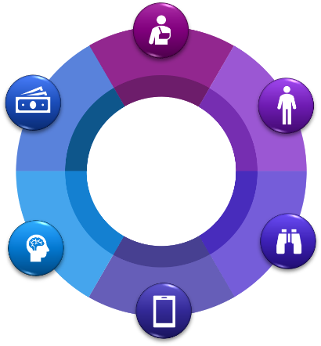
Emotional, Psychological & Verbal Abuse
Extreme jealousy or possessiveness.
Often phones or unexpectedly shows up.
Is angry if they are 5 minutes late.
Made to feel worthless/ not worthy of love.
Is unpredictable.
Made to feel they never say/do anything right.
Blames them for the abuse or denies abuse happened.
Calls them names.
Threatens to commit suicide if they leave or
tells them they’ll never be able to leave.

Slide 17
GINGERBREAD
MAN EXERCISE

Slide 18
No one will ever want you
Bad parent
Stupid
Ugly
Fat
Crazy

Slide 20
No one will ever want you
Bad parent
Stupid
Ugly
Fat
Crazy

Slide 21
Isolation Abuse
Starts a fight when they want to leave or makes them feel guilty for leaving.
Doesn’t let them spend time with their family or friends.
Makes them feel guilty for spending time with other people.
Accuses them of having affairs.
Makes them late for work.
Controls what they can or can’t do.

Slide 22
?
TIME TO KAHOOT!

Slide 23
Digital Abuse
Constantly calls or texts.
Reads their messages or text conversations.
Tells them who they can or can’t be friends with on social media.
Sends threatening or insulting messages.
Reveals private information, secrets, or photos of them online.
Demands access to online accounts.

Slide 24
Economic Abuse
Makes them account for every dime they spend.
Refuses to give their partner money for food, gas or medicine.
Steals money from them or lies about how money is spent.
Prevents them from going to work.
Demands that they quit their job.
Harasses them at work.
Forces them to give them the money they earn.
Forces them to give them their income tax refund.

Slide 25
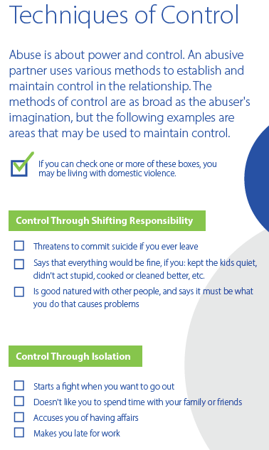
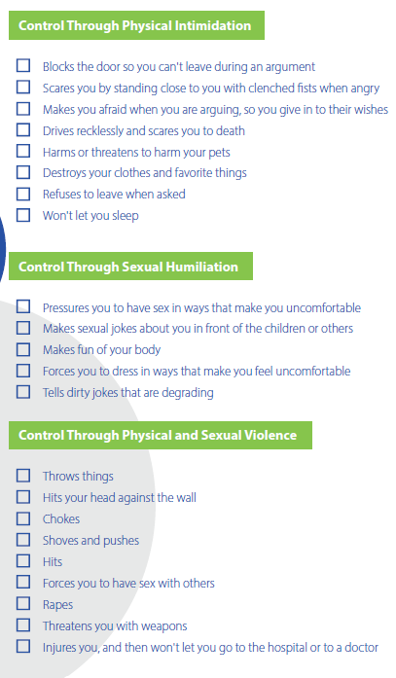
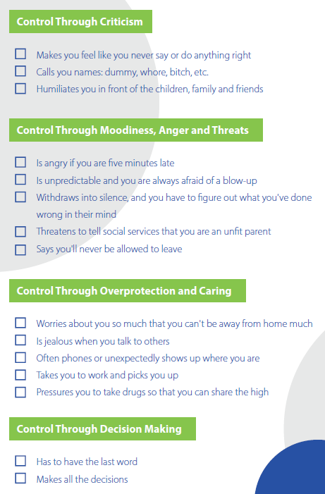

Slide 26
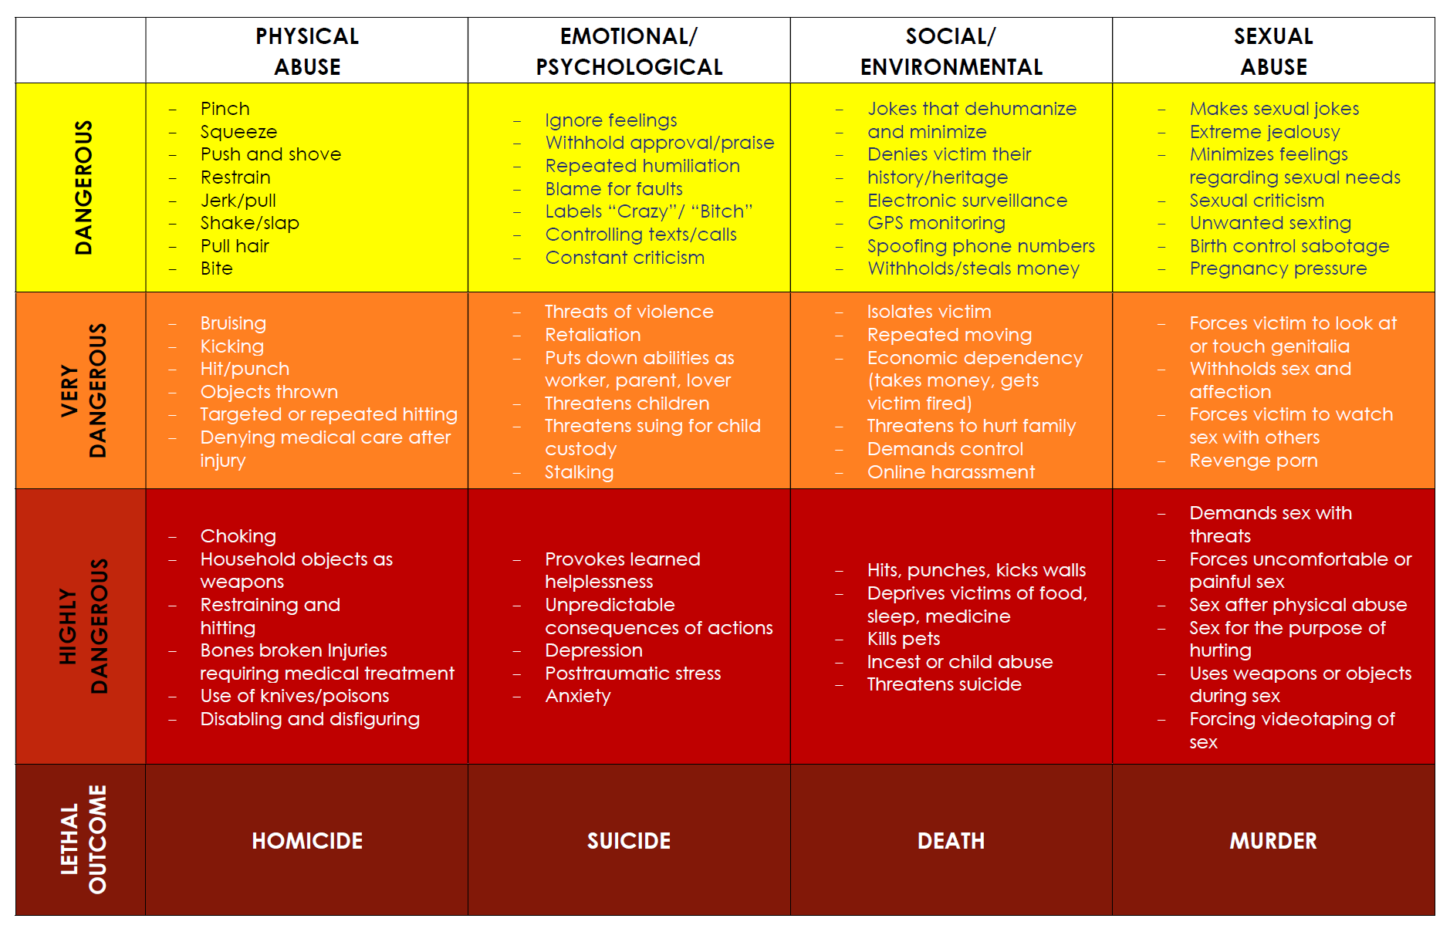
CHART OF DANGEROUS BEHAVIORS

Slide 27
?
TIME TO KAHOOT!

Slide 28
EFFECTS OF DOMESTIC VIOLENCE
Societal
Emotional
Behavioral
Physical

Slide 29
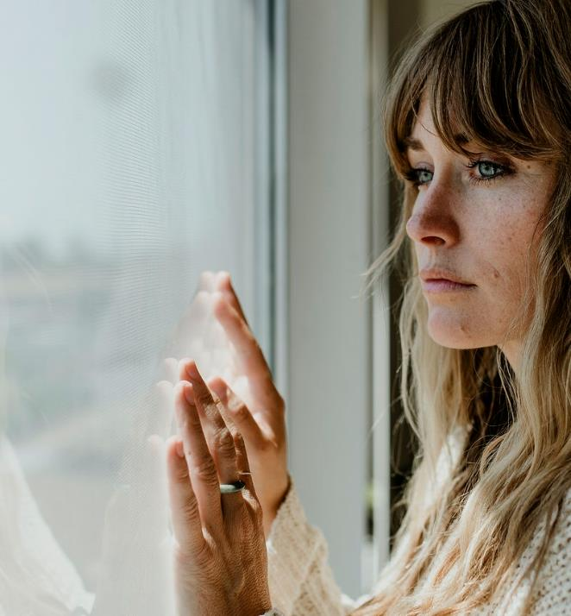
EMOTIONAL EFFECTS
Anxiety attacks.
Low self-esteem.
Fear of the abuser or living without the abuser.
Confusion and trouble concentrating.
Anger.
Grief for family and personal losses.
Shame, guilt or self-blame.

Slide 30
EMOTIONAL EFFECTS
Post-Traumatic Stress Disorder (PTSD)
Mental health condition that originates with the experience of a terrifying event or events.
Symptoms:
persistent, intrusive thoughts of the events,
hyperarousal to threats,
avoidance of reminders of the events.
Effects:
negatively affect ability to manage life stressors.

Slide 31
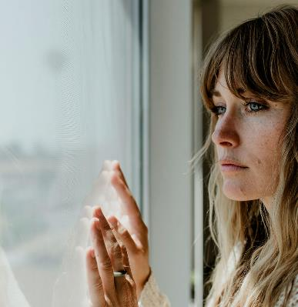
EMOTIONAL EFFECTS
Depression
Mental health condition characterized by persistent feeling of sadness or loss of interest in previously enjoyed activities.
Symptoms:
loss of interest in activities once enjoyed
loss of energy
feelings of hopelessness and/or sadness
unexplained crying
changes in appetite with significant weight loss/gain
Effects:
Serious, negative impact on thought process and decision-making ability

Slide 32
EMOTIONAL EFFECTS
Dissociation
Feeling like one has “checked out” or is not present.
Symptoms:
checked out mental state/detachment from self
daydreaming
memory loss
Effects:
Inability to cope
Blurred sense of identity
Stress in relationships, work or other areas of your life

Slide 33
?
TIME TO KAHOOT!

Slide 34
BEHAVIORAL EFFECTS
Withdrawal.
Avoidance of situations reminding the individual of the abuse.
Mood swings and difficulty controlling emotions.
Difficulty in obtaining, maintaining and adjusting to employment.
Jumpiness or agitation.
Self-medication.

Slide 35
SOCIAL EFFECTS
Isolation from friends or family.
Difficulty trusting others.
Stormy relationships.
Breakup of the family unit.
Court disagreements regarding separation, divorce or custody of children.
Seeking new relationships to deal with overwhelming feelings of loneliness.

Slide 36
PHYSICAL EFFECTS
Sleep deprivation
Bodily/stomach complaints, headaches
Nervousness / anxiety
Chronic health problems
Injuries or death from physical abuse
Chronic fatigue
Shortness of breath
Muscle tension
Involuntary shaking
Changes in eating or sleeping patterns
Sexual dysfunction
In women: issues with menstrual cycle or fertility

Slide 37
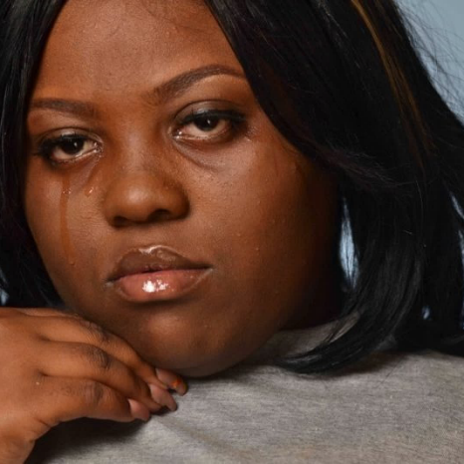
TRAUMA-INFORMED MINDSET
Domestic violence is often not a one-time event or a single trauma
Often adverse childhood events
MOVE FROM:
What is wrong with you?
TO:
What has happened to you?

Slide 38
THERE IS HOPE
It is possible to move past and triumph over the effects of domestic violence.
It may require facing painful truths and also means uncovering new strengths.
The process needs safety, time and space.
The effects will lessen with time.
Survivors can ultimately reclaim positive relationships.

Slide 39
Mallery’s Story

Slide 40
Break
A FEW REMINDERS
Post-Test & Evaluation
Take the post-test at the end of today’s session and help us measure effectiveness and improve!
Knowledge Test
Pay attention. A brief knowledge test will be given at the end of the presentation in order to receive a Certificate of Participation, the PowerPoint and to apply to become a Safe Place.
Safe Places
Your business can apply to become a Safe Place. Go to PurpleOne.org/SafePlaces for more info.

Slide 41
HOUSEKEEPING ITEMS
This training DOES NOT certify you or qualify you to provide domestic violence services as an individual or through your business. You are being trained to REFER victims to state-recognized domestic violence services agencies.
Post-Test & Evaluation
Knowledge Test
Self Care
Safe Places
Helps us measure effectiveness and improve!
Receive CEUs, Certificate of Participation and be eligible to apply to become a Safe Place.
Be aware of triggers and remember to take care of yourself! Chat with us or call our hotline if needed.
Your business can apply to become a Safe Place.

Slide 42
ABUSE IS NOT ABOUT BEING OUT OF CONTROL
Abusers deliberately choose all aspects of the abuse. Domestic violence is about POWER and CONTROL. They Choose:
WHO THEY ABUSE
WHEN THEY ABUSE
WHERE THEY ABUSE
METHOD OF ABUSE
SEVERITY & FREQUENCY
OF ABUSE

Slide 43
ABUSER PROFILE
Controlling
Manipulating
Entitled
Disrespectful
Attitude of Ownership
They believe the victim belongs to them.

Slide 44
ABUSER PROFILE
Most DO NOT have psychological disorders.
They believe they have a RIGHT to control.
Use childhood and emotions as EXCUSES.
Comfortable LYING.

Slide 45
ABUSER PROFILE
The victim may seem disjointed, out of control, agitated.
The abuser may seem friendly, articulate and calm.

Slide 46
?
TIME TO KAHOOT!

Slide 47
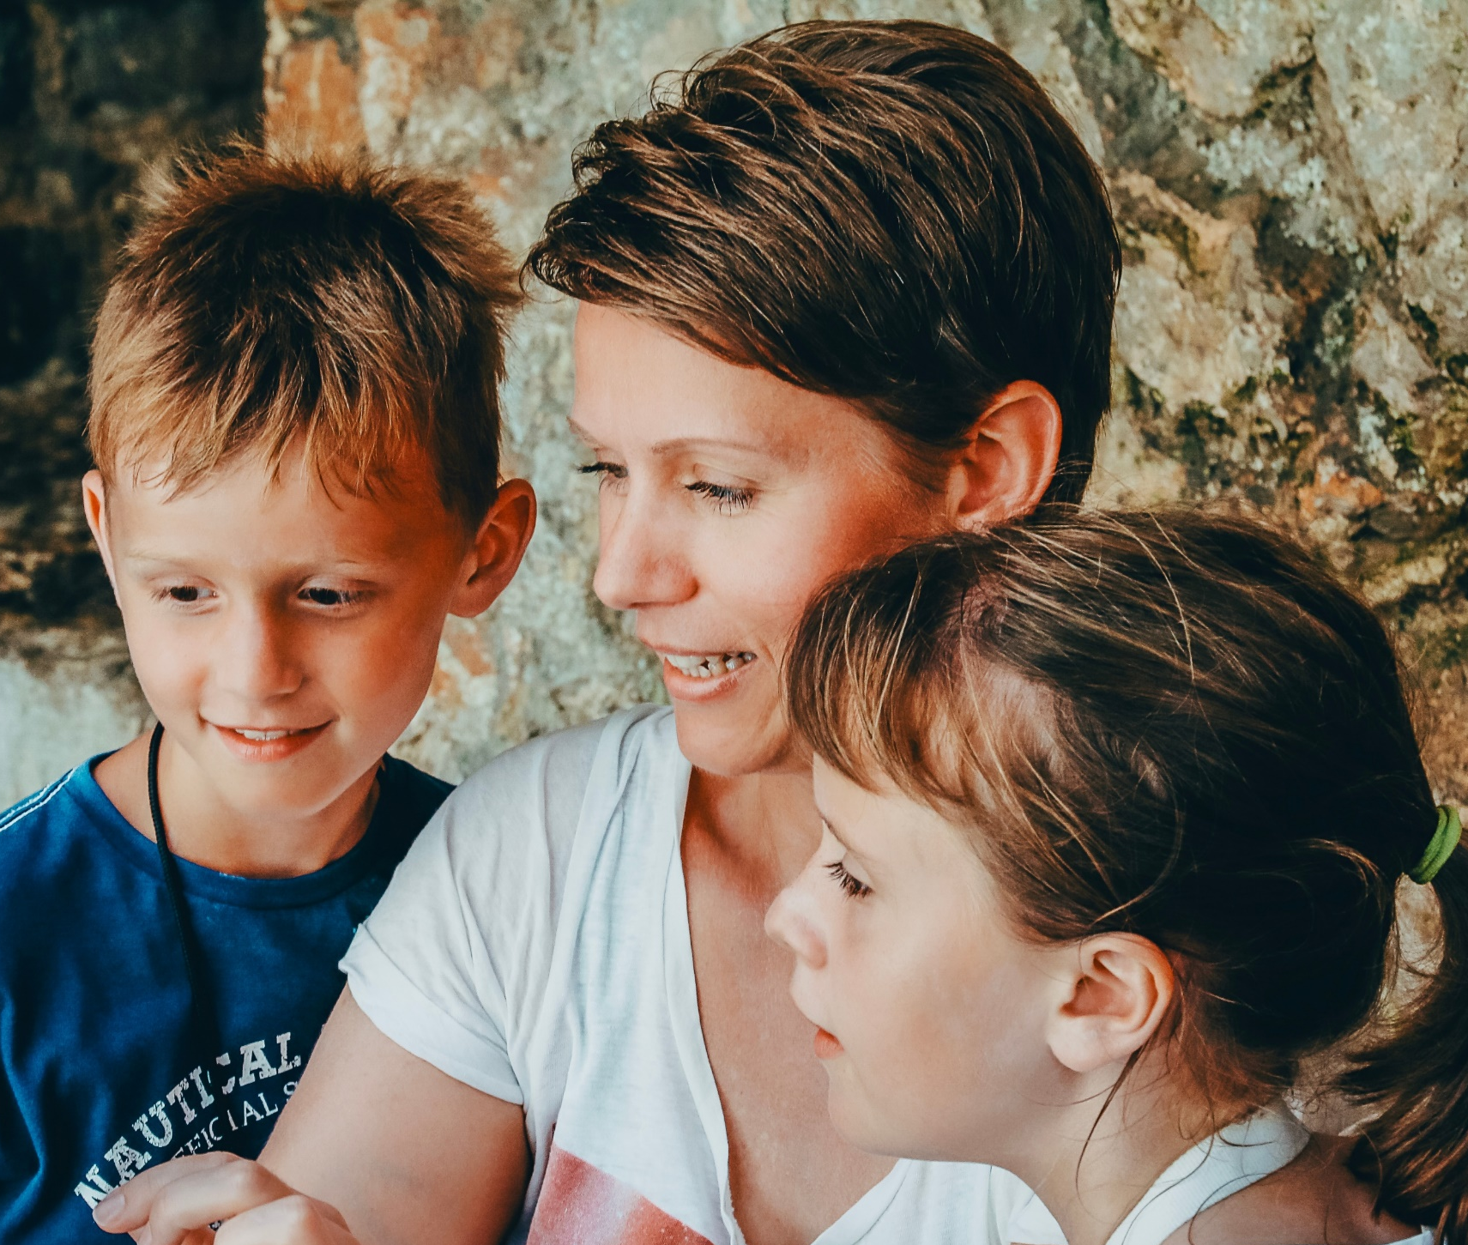
IN HER SHOES
Imagine you are a woman who has been married for 12 years. You have 2 children, a son, 10; and a daughter, 7. Your daughter has recently been diagnosed with a medical condition. And, you have a 6-year-old cat or dog.

Slide 48
IN HER SHOES
Will you stay or go?
If you go, where will you go? Choices: friends and family, hotel, apartment, shelter
What will you do with your children?
What will you do with your pet?

Slide 49
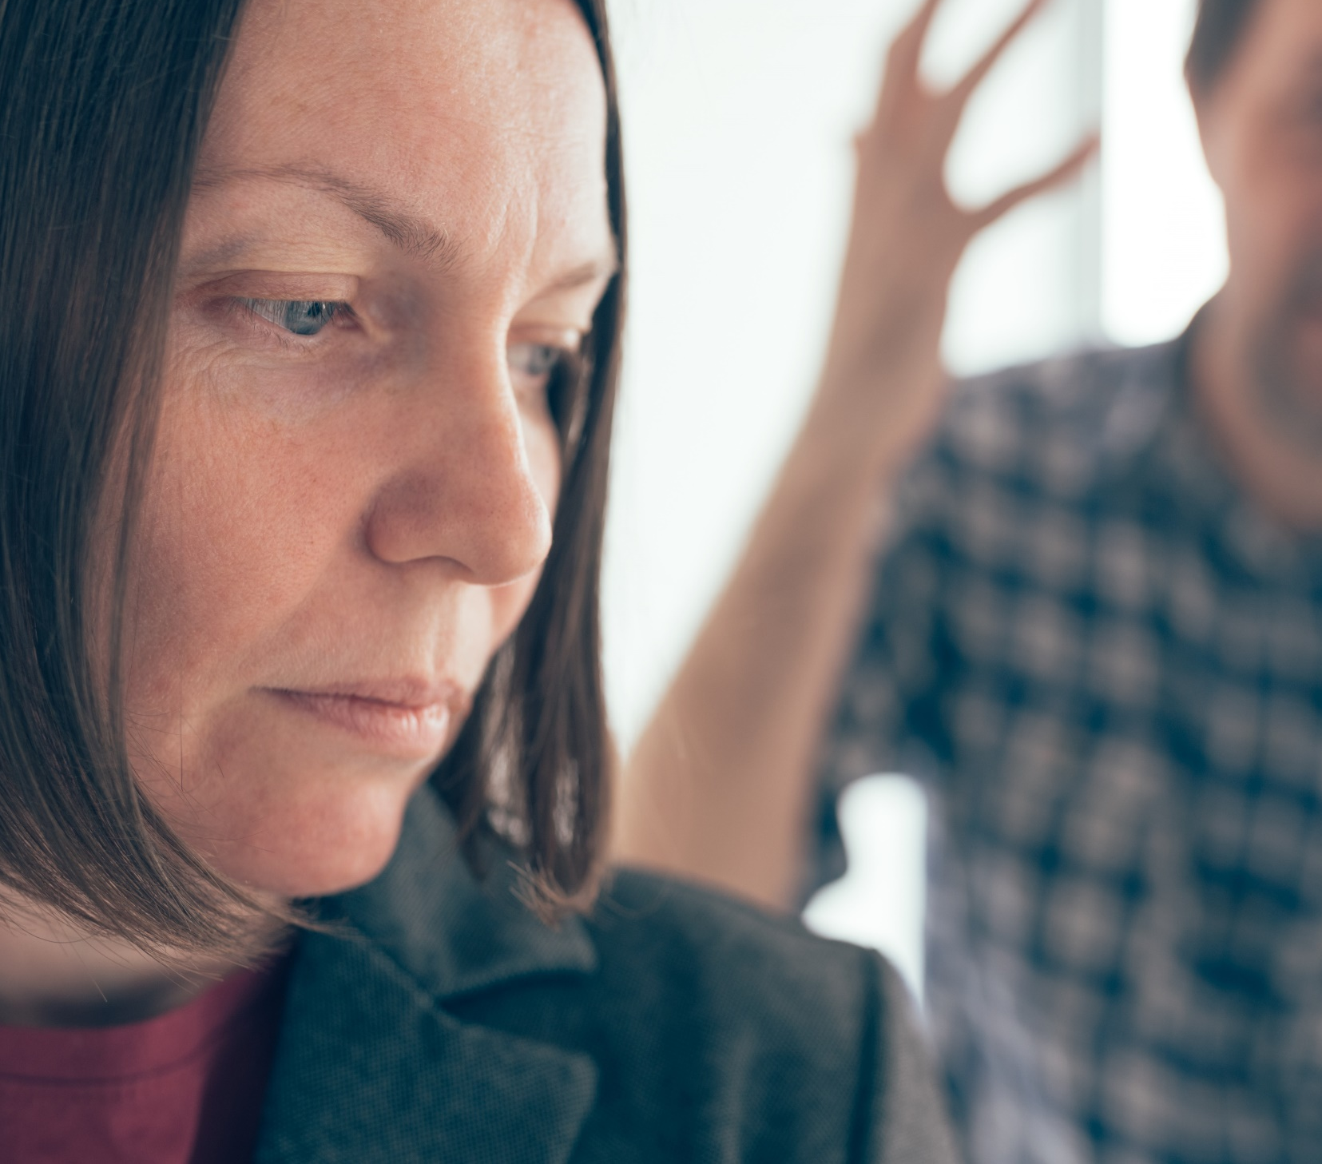
IN HER SHOES
Your friends who you used to go out with every month are back in town. You made plans to go out with your friends. As you prepare to leave, your husband yells at you, telling you to get your priorities straight. He is so upset that you call and cancel your plans because his anger is escalating.
What do you do now?
Do you stay or do you leave?
Where do you go?
What decisions do you make for your children?
What about your cat / dog?

Slide 50
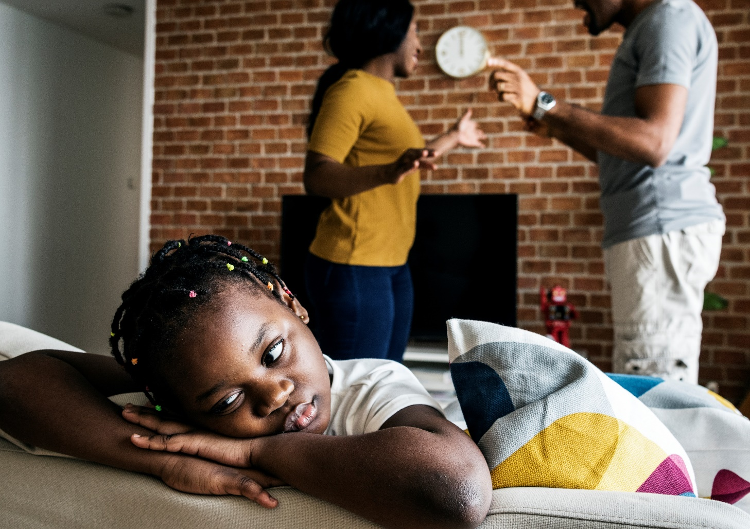
IN HER SHOES
A few days later, you have plans to go to your son’s basketball game. Your husband comes home after a bad day at work. He is upset because you planned pizza for dinner instead of cooking a homemade meal. You decide to go to the game anyway. Your husband grabs your arm so hard it leaves bruises, and he pushes you against the wall. Your children are feeling anxious and scared, and they want to leave.
After the game, what do you do? Do you stay or do you leave? Where do you go? What decisions do you make about your kids? What about your cat / dog?

Slide 51
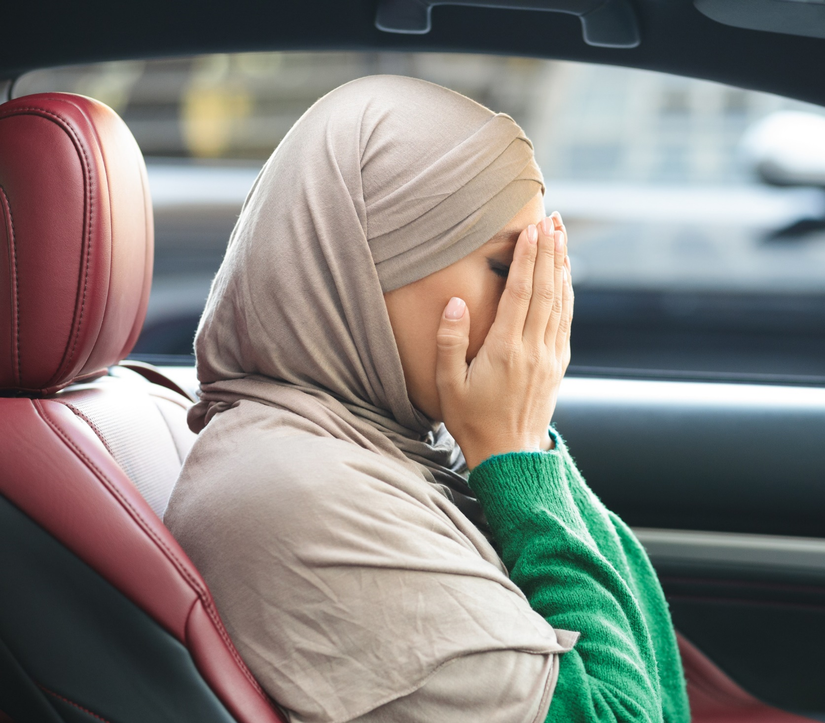
IN HER SHOES
You and your husband get in an argument. On the way to the car, he continues to yell at you and intentionally slams the door shut on your hand.
What do you do?
Do you stay or do you leave?
Where do you go?
What decisions do you make for your children?
What about your cat / dog?

Slide 52
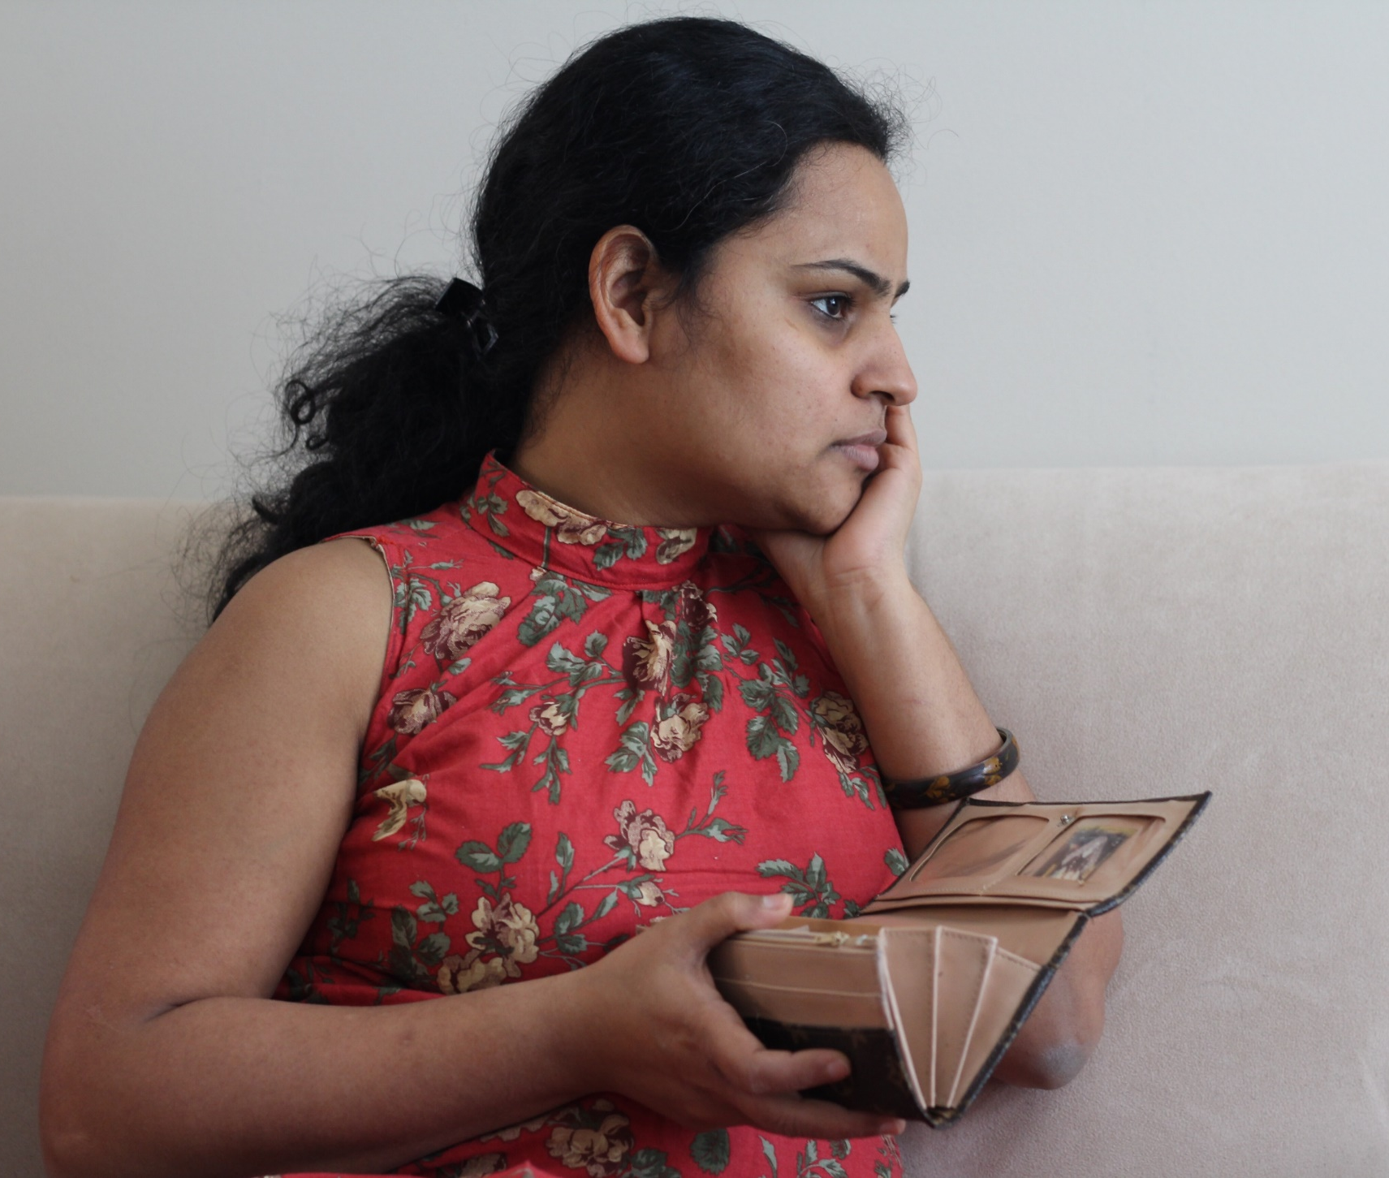
IN HER SHOES
Wherever you are, you left with practically nothing. Your husband canceled your ATM and credit cards. The only cash you have is the $100 in your purse. You have a few changes of clothes for you and your kids.
What do you do?
Do you stay or do you leave?
Where do you go?
What decisions do you make about your kids?
What about your cat / dog?

Slide 53
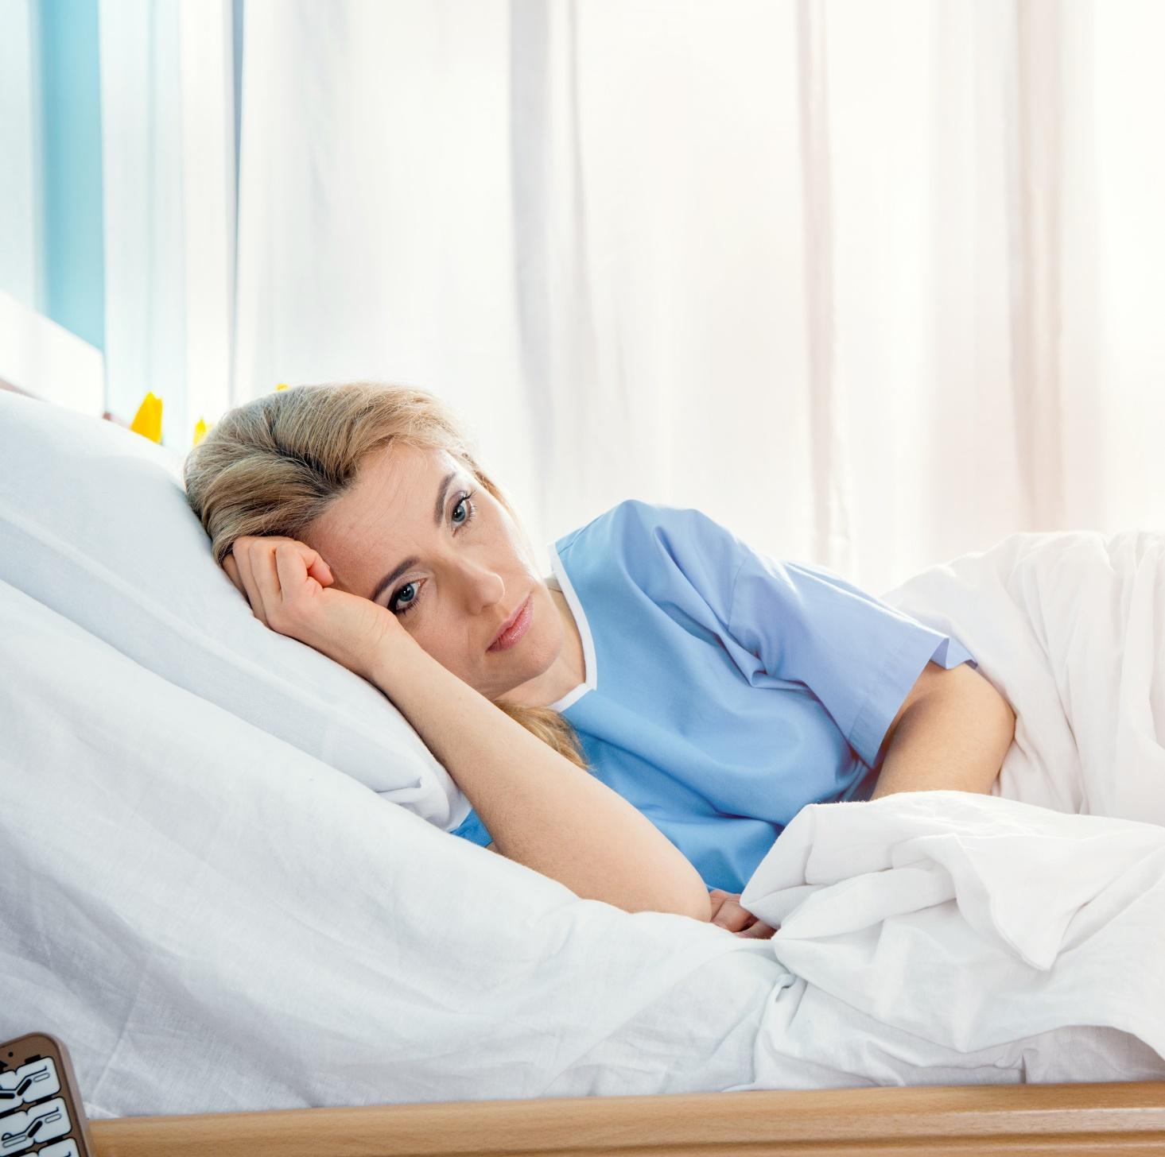
IN HER SHOES
Several weeks later, another incident happens. Your husband is upset because dinner is not ready at 5:00. It escalates to the point that he pushes you and breaks a couple of your ribs. He allows you to go to the emergency room, but threatens if you tell anyone what happened, he will kill you and the kids. What do you do?
Do you stay or do you leave?
Where do you go?
What decisions do you make about your kids?
What about your cat / dog?

Slide 54
IN HER SHOES
To those staying with family or friends: You start to overstay your welcome and you overhear them talking about asking you to leave because they afraid of your husband.
To those living in a hotel:
You are out of money and need to find another option. Your kids are stressed with all the changes and moving that’s happening.
To those living in an apartment: Your neighbors saw your husband sneaking around your apartment and causing a ruckus. Your landlord puts you on notice that if your husband continues coming around you will be asked to leave.
To those staying at shelter:
Know that your time at the shelter is limited. You and the staff have been planning for what you will do next.
Your husband starts to stalk you. You find footprints outside your bedroom window. While you were at the school, he leaves a threatening note on your
windshield.
What do you do?

Slide 55
IN HER SHOES
It’s another night where your husband is angry. He grabs his handgun and lays it on the dining room table. He threatens to kill you and says you will never see the kids again.
What do you do?
Do you stay or do you leave?
Where do you go?
What decisions do you make about your kids?
What about your cat / dog?

Slide 56
Letters to Domestic Violence Victims

Slide 57
WHY VICTIMS STAY
Stay to protect the children
Religion
If they get them to stop drinking, the abuse will
end
Not sure if it really is abuse
Don’t have the money
They love them
Immigration status
Belief
if they were a better parent and partner they will
stop
They can get them to learn to control their anger
Think their friends and family wont believe them
No options or choices
Believe they will
change
Believe the abuse is their fault
Threatened to kill them if they left
No where to go

Slide 58
BARRIERS TO LEAVING
Dynamics of domestic violence
Victim safety
Inability to hold offenders accountable

Slide 59
LEAVING IS A PROCESS
Leaving DOES NOT Ensure Safety!
IMPORTANT
Accept where they are even if you don’t agree or fear for their safety.
REMEMBER
Every time the victim talks about it or leaves, they reclaim some of the strength taken from them by the abuser.

Slide 60
LETHALITY
LETHALITY RISK Checklist
Likelihood of lethality correlates with the number and intensity of the following indicators.
Threats/thoughts of homicide and suicide
Kidnapping or hostage taking
Possession or access to weapons
Sexual assault or rape
Use of weapons in a threatening or intimidating manner
Prior abusive incidents that resulted in serious injury
Extreme jealousy or obsession with the victim
History of violence with previous partners and children
Physical attacks, verbal threats, and stalking during a separation or divorce
Psychopathology or substance abuse
CHECK NOW

Slide 61
SEPARATION VIOLENCE
Leaving doesn’t end violence. The most dangerous time is when they leave the abuser.
75% killed during or after separation.
5x more likely to be killed during separation.
33% of all female homicide victims are killed by an intimate partner.

Slide 62
THE FACTS
Victims don’t LEAVE.
They ESCAPE.
Despite the abuse, victims become strong survivors.

Slide 63
?
TIME TO KAHOOT!

Slide 64
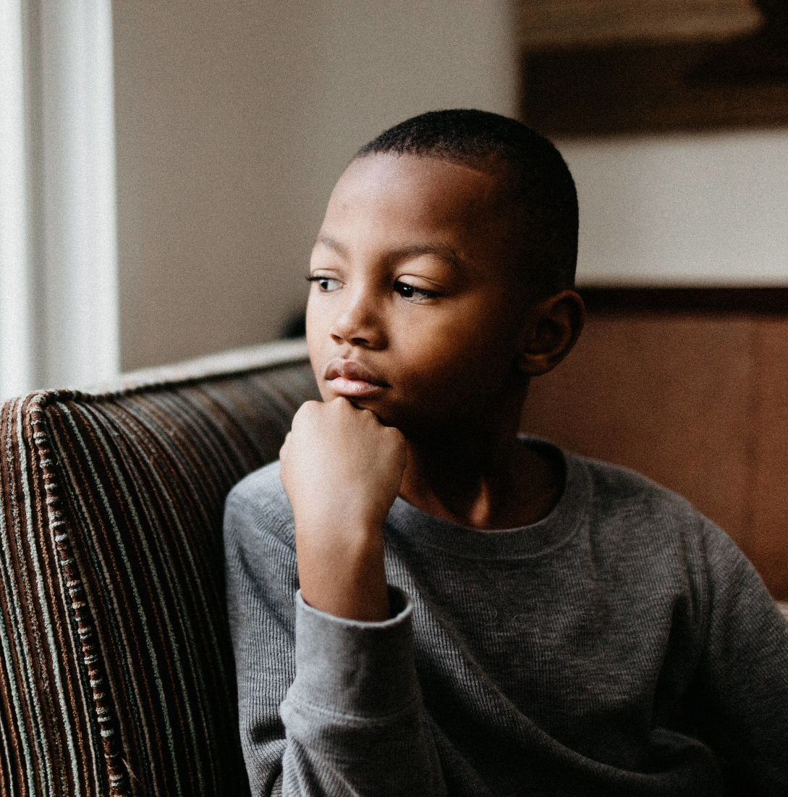
THE EFFECT ON CHILDREN
The 19 Million Witnesses
They know about the abuse.
The children are at greater risk of being violent themselves or becoming a victim in their future relationships

Slide 65
If A Kid Could Write A Letter

Slide 66
NEXT STEPS

Slide 67
YOU CAN HELP
Victims of domestic violence are survivors of traumatic experiences.
Trained members of the community can make a difference.
YOU CAN: Refer victims to state recognized domestic violence agencies who are trauma-informed.

Slide 68
When you hear bystander, what is the first thing that comes to mind?

Slide 69
?
TIME TO KAHOOT!

Slide 70
BYSTANDER DEFINITIONS
Bystanders
Observe potentially harmful and criminal situations and are faced with the choice to act in a positive way, negatively contribute or passively ignore the situation.
Prosocial Bystanders
Individuals who positively impact the outcome of a harmful situation, often by positively affecting the incident and supporting the victim.

Slide 71
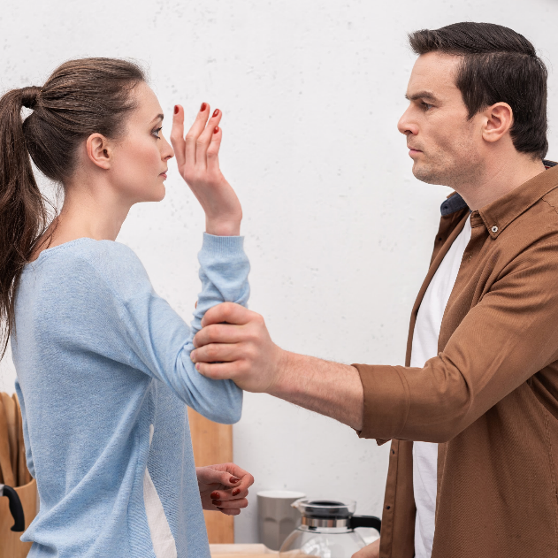
PERSONAL SCENARIO
Think about a time when you did intervene.
Think about a time when you chose to not take action and were a passive bystander?
What was it about this situation that prevented you from taking action?

Slide 72
OBSTACLES
PERSONAL
PHYSICAL
Being shy, afraid, unsure.
Not wanting to embarrass yourself
01
02
Physical size
Lack of being present
Negative Outcomes
RELATIONSHIP
SOCIAL
What other will think
Seen as a tattletale
Losing friends/peer pressure
03
04
Diffusion of responsibility
Don’t want to make a scene
Blowing it out of proportion

Slide 73
PERSONAL SCENARIO
YOU CAN HELP
Someone you care about is in danger. A bystander is there but doesn’t help.
How do you feel?
Imagine the bystander steps in and stops the harm.
How do you feel?

Slide 74
KITTY GENOVESE
STORY
Kitty was stalked and stabbed.
Witnesses heard/saw the attack, but little was done.
She died.

Slide 75
YEARDLEY LOVE STORY
Who were the bystanders?
Yeardley Love and George Huguely V were student athletes at the University of Virginia who were in a dating relationship.
Then one night he killed her.
Photo Credit: UVA Media Relations

Slide 76
?
TIME TO KAHOOT!

Slide 77
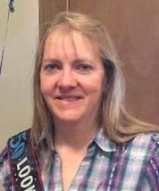
KAREN LECLAIR STORY
Karen Leclair’s husband shot her on their commercial fishing vessel and threw her body into Lake Erie.
He told acquaintances of his plan on several occasions before her death.
He left clues about his specific plan.

Slide 79
Break
A FEW REMINDERS
Post-Test & Evaluation
Take the post-test at the end of today’s session and help us measure effectiveness and improve!
Knowledge Test
Pay attention. A brief knowledge test will be given at the end of the presentation in order to receive a Certificate of Participation, the PowerPoint and to apply to become a Safe Place.
Safe Places
Your business can apply to become a Safe Place. Go to PurpleOne.org/SafePlaces for more info.

Slide 80
BYSTANDER RESEARCH
PROSOCIAL CONDITIONING
AWARENESS
INVITED TO HELP
SKILLS AND KNOWLEDGE

Slide 81
DOMESTIC VIOLENCE CONTINUUM
Domestic Violence Behaviors
Not a big deal Inappropriate Violent
Name Calling
Throws things
Murder
Putting Down
Shoves or pushes
Strangle
Threatens to hit or kill
Choke
Constant Calls/Texts
Isolation
Hit
High Prevalence in society Low

Slide 82
DOMESTIC VIOLENCE THRIVES
Speak Up when you hear sexist jokes or comments disrespecting women.
STEP Up and SPEAK Up
Enablers
Promote the PurpleOne Training.
Be aware of your personal biases.
Traditional gender roles
Economic, social, gender inequalities
Speak up when you hear someone asking, “why does the victim stay?” Address the
abuser and their actions.
Domestic violence offenders
Social/
Cultural norms supporting violence
Perpetrators not being held accountable legally or socially
Blaming the victim
Male entitlement
Passive bystanders
Speak Up if we see abuse of any kind happening among our family, friends or in our workplace.
Hold abusers accountable. Question whether abusers should be holding leadership roles in our churches, coaching, etc.
Engage more men to get trained to Step Up and Speak Up against domestic violence.

Slide 83
Bystanders witness 66% of violent crimes.
BYSTANDERS
MAKE A
DIFFERENCE
Bystanders are significantly more likely to make a situation better than make it worse.
A close friend is the most likely person to be told in the case of domestic violence.
If one person intervenes, others will most likely follow.
YOU CAN. Make a Difference.

Slide 84
WAYS BYSTANDERS MAKE A DIFFERENCE
01
PREVENT THE EVENT
PREVENT
In many cases, stepping in may stop a more significant event from occurring.
STOP THE EVENT
02
03
SUPPORT
Even if an event is in progress, stepping in can stop it from escalating.
By stepping in, you may provide the victim support that they may not have known existed.
STOP
SUPPORT

Slide 85
DECISION-MAKING PROCESS
ACT
When should I take action?
What resources – people, phone, etc., are available to me?
Take action.
PLAN
What can I do to keep myself safe?
What are my options?
Are there others who can help?
What are the costs/benefits for taking action?
ASSESS
Is there a problem or potential situation?
Does someone need help?
Can I and others be part of the solution?

Slide 86
DECISION-MAKING PROCESS
close up
least safe
safest
Close up
by yourself
with others
Alone
With others
Distant
far away

Slide 87
?
TIME TO KAHOOT!

Slide 88
TRAINEE RESPONSIBILITY
Recognize. Respond. Refer.
Refer victims to state-recognized domestic violence agencies.
You ARE NOT a counselor and should not tell someone what to do.
Call Your Agency Name with questions: Agency Phone

Slide 89
WHAT YOU CAN DO
01.
02.
03.
Call 911.
Directly address the situation.
Speak up-use “I” statements
Focus on your feelings rather than criticizing the other person. Feelings, Behavior, Desired Response.
Step in and say or do something to stop the situation.
04.
05.
06.
07.
Interrupt the Situation
Distract
Initiate Help.
Don’t Act Alone.
Try to interrupt the harasser or insert yourself into their interaction to help the targeted person get out of the situation.
Redirect the attention of those behaving inappropriately using a simple (or elaborate) distraction to diffuse the situation.
Get help from authority figures near the situation.
Gather others to help you when addressing the situation.

Slide 90
WHAT YOU CAN DO
TO BE HELPFUL TO THE VICTIM
DO:
Prioritize your safety and the safety of the victim.
Believe what the victim says.
Be patient, respectful and non-judgmental.
Remind the victim that no one deserves to be abused.
Reassure the victim that there is an agency that can help.
Have as much information available as possible.
The Most Important Thing to Ask a Victim is “Are You Safe?”
TO BE HELPFUL TO THE VICTIM DO NOT:
Don’t panic. Try to remain calm. Don’t blame the victim. Don’t assume the violence is not serious. | Don’t give advice. You are not in a position to give advice, leave that to the experts. Don’t act as a mediator between the 2 parties. Don’t think you have to have all the answers. Your job is to Recognize. Respond. and Refer.

Slide 91
APPLIED WAYS TO PROVIDE BYSTANDER ASSISTANCE

Slide 94
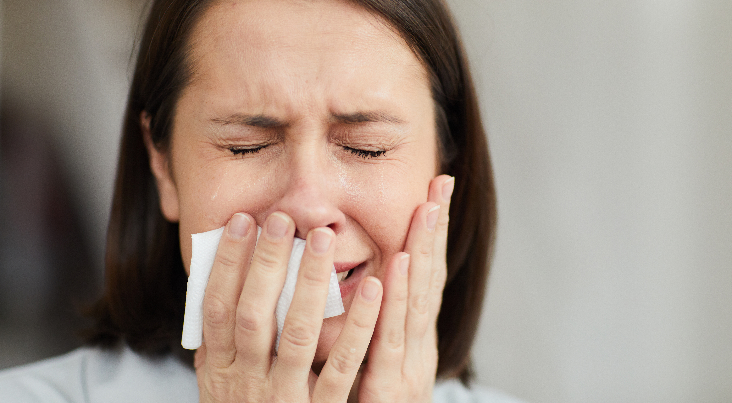

Slide 95
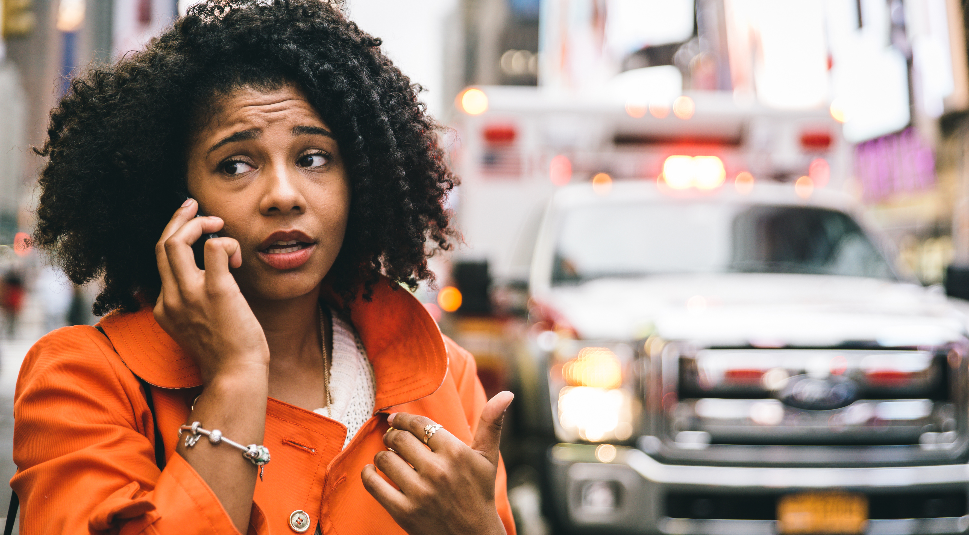

Slide 96
CONSIDERATIONS WHEN DEALING WITH A POTENTIALLY VIOLENT PERSON

Slide 97
COMMUNITY
SCENARIO
Decision-making process:
What are the pros and cons?
Do nothing and leave. It’s none of my business.
Go to my car and wait 15 minutes to see if it escalates.
Call 911.
Your own idea:
ASSESS THE SITUATION
You have just finished shopping at your local grocery store. When walking back to your car, you observe a man and a woman yelling at each other. The man gets up in the face of the woman, calling her vulgar names and telling her she is “a worthless piece of $#%*.”
DOES SOMEONE NEED HELP?
AM I THE ONE TO HELP?
ARE DRUGS & ALCOHOL INVOLVED?
What do you do? How do you stay safe?
WILL ESCALATE INTO VIOLENT SITUATION?

Slide 98
PARK SCENARIO
You are walking through your local park. You come upon a person in the middle of the path looking around and frantically sobbing.
What do you do?

Slide 99
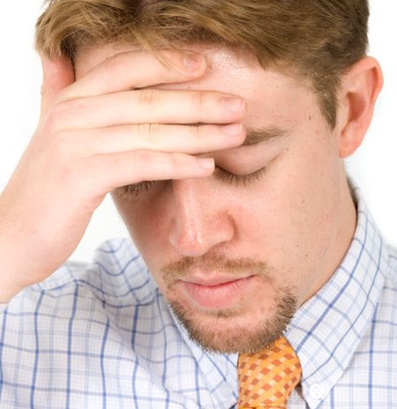
FRIEND/ GUN SCENARIO
Your friend tells you he called 911 last night because his husband was threatening to kill him. He said his husband even showed him the gun he was going to use, and then showed him the bullet. His husband pushed the bullet hard against his forehead and said, "It's going right through there."
How can you help your friend?

Slide 100
?
TIME TO KAHOOT!

Slide 101
HE’S HERE SCENARIO
For a couple of years, you've tried to convince your friend to get out of a violent relationship. You notice things have gotten much more serious over the last month; you've seen a lot more bruises. Today she calls and says last night things were so bad she tried to leave. But he grabbed her before she could get out the door. He threatened her if she dared call the police. There are moments in the conversation when your friend sounds terrorized, but mostly she seems paralyzed by numbness, despair, and exhaustion. Suddenly she says, "He's here." and hangs up. How can you help your friend?

Slide 102
?
TIME TO KAHOOT!

Slide 103
Domestic Violence PurpleOne Awareness

Slide 104
WHAT IS A SAFE PLACE?
Organizations may apply to become a Safe Place for Domestic Violence Victims
Safe Places must be businesses with physical locations that agree to provide information to victims and refer victims to the local state-recognized domestic violence agency.
Apply at purpleone.org/safeplaces

Slide 105
SAFE PLACE RESPONSIBILITY
Organizations may apply to become a Safe Place for Domestic Violence Victims
Recognize. Respond. Refer.
Refer victims to state-recognized domestic violence agencies.
You ARE NOT a counselor and should not tell someone what to do.
Call PurpleOne with questions: (814) 616-2330.
Apply at purpleone.org/safeplaces

Slide 106
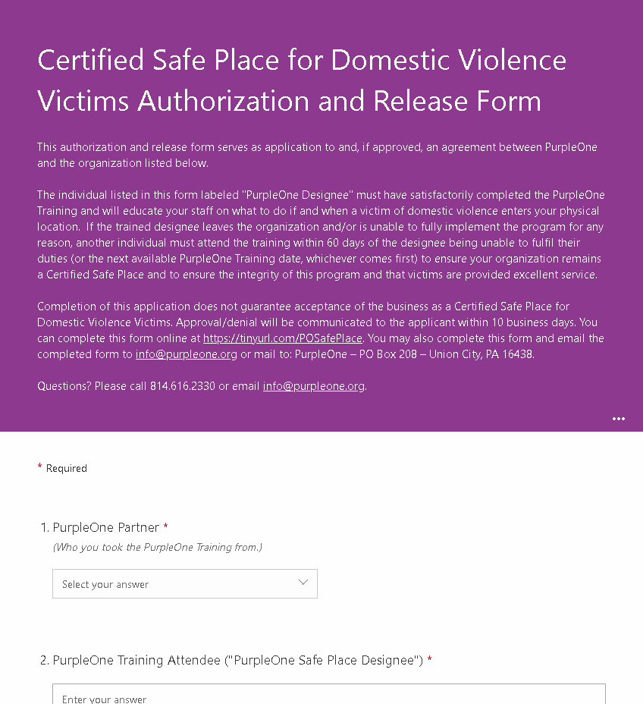
SAFE PLACE APPLICATION
Apply online
Application is reviewed by local agency and PurpleOne Office
Agreement is signed
Receive your Welcome Packet electronically and your PurpleOne Dot and poster in the mail
purpleone.org/safeplaces

Slide 107
PURPLEONE DESIGNEE
Help educate your organization
Distribute materials
Serve as the Connection between PurpleOne and your organization
PurpleOne will provide you templates and materials, including the PurpleOne Dot to display.
purpleone.org/safeplaces

Slide 109
CONCERNED ABOUT BECOMING A SAFE PLACE?
Being trained, making a plan and adding policies and procedures actually makes you and your business safer.
Apply at purpleone.org/safeplaces

Slide 110
CO-WORKER SCENARIO
A co-worker comes to you extremely agitated and shares with you that their spouse beat them last night. They say they don’t know what to do. You can see they are very upset.
What can you do to help?

Slide 111
?
TIME TO KAHOOT!

Slide 112
SCENARIO
PURPLEONE
A woman walks into your place of business. She appears nervous and hesitant to approach you. She browses a bit, and eventually walks over and says:
“So, I saw that PurpleOne Dot in your window.”
How do you respond?

Slide 113
?
TIME TO KAHOOT!

Slide 114
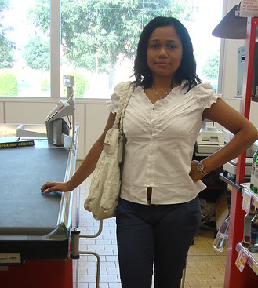
SCENARIO
PURPLEONE
A customer comes in browsing at your store. After a bit you notice someone standing back keeping a close eye on the customer.
What do you do?

Slide 115
Services
LEGAL & SUPPORT SERVICES
We’re here to help you help victims.
Agency Name
Serving Service Area
Services listed
Enter general information about your agency here.
COUNSELING SERVICES
Agency Phone | Agency Email

Slide 116
Dear Victim, You Are Not Alone

Slide 117
REFER VICTIMS
Agency URL
Agency Phone
Agency Email

Slide 118
?
TIME TO KAHOOT!

Slide 119
YOUR NEXT STEPS
1
Certificates
You will receive your certificate in your email after you complete the post-test and evaluation.
TAKE POST-TEST
2
Share on Social Media
PROMOTE TRAINING
Tell others about our next training: DATE
Distribute Flyers and Posters
3
DISTRIBUTE INFORMATION
Print off the handouts provided after today’s training and hand them out!
SAFE PLACE APPLICATION
Business Can Apply to Be a Safe Place
4
Now that you’re trained, your business can apply to become a Safe Place for Domestic Violence Victims.
HELP SOMEONE
Recognize. Respond. Refer.
5
You Can make a difference. We’re here to help if you need us!

Slide 120
?
TIME TO KAHOOT!

Slide 121
POST-TEST & EVALUATION
Use the QR CODE or go to https://qrco.de/PurpleOnePostTest to take the post-test and evaluation to help us continue to improve.
You will need to pass the knowledge test to receive your certificate, CEU credits and apply to become a PurpleOne Safe Place, if you choose to do so. After you take the post-test, you will receive a link to download the slide deck from today’s training, handouts and a Response Card.
Test Questions? info@purpleone.org or (814) 616-2330

Slide 122
CONTACT US
Agency URL
Agency Phone
Agency Email

Slide 123
THANK YOU
DON’T FORGET TO TAKE THE POST-TEST
This project was supported by Grant No. 2017-CY-AX-0004 awarded by the Office on Violence Against Women, U.S. Department of Justice. The opinions, findings, conclusions, and recommendations expressed in this publication/program/exhibition are those of the author(s) and do not necessarily reflect the views of the Department of Justice, Office on Violence Against Women.

Slide 124
RESOURCES
This training was informed by the following resources:
Black, M.C., Basile, K.C., Breiding, M.J., Smith, S.G., Walters, M.L., Merrick, M.T., Chen, J., & Stevens, M.R. (2011). The National Intimate Partner and Sexual Violence Survey (NISVS): 2010 Summary Report. Atlanta, GA: National Center for Injury Prevention and Control, Centers for Disease Control and Prevention.
Centers for Disease Control and Prevention. (2021). Preventing intimate partner violence. https://www.cdc.gov/violenceprevention/intimatepartnerviolence/fastfact.html.
Fischer, P., Krueger, J. I., Greitemeyer, T., Vogrincic, C., Kastenmüller, A., Frey, D., and Kainbacher, M. (2011). The bystander effect: A meta-analytic review on bystander intervention in dangerous and non-dangerous emergencies. Psychological bulletin, 137(4), 517-537.
Fortune, M. M. (2006). National declaration of religious and spiritual leaders addressing violence against women. Journal of religion and abuse, 8(2), 71-77.
Hamby, S. L., Weber, M. C., Grych, J. H., & Banyard, V. (2016). What difference do bystanders make? The association of bystander involvement with victim outcomes in a community sample. Psychology of violence, 6(1), 91-102.
Holson, L. M. (2019, April 12). Murders by intimate partners are on the rise, study finds. New York Times. https://www.nytimes.com/2019/04/12/us/domestic-violence-victims.html.

Slide 125
RESOURCES
Morgan, R. E., & Oudekerk, B. A. (2019). Criminal victimization, 2018. Bureau of Justice.
Pagelow, M.D. (1990), Effects of domestic violence on children and their consequences for custody and visitation agreements. Mediation Quarterly, 7, 347-363. https://doi.org/10.1002/crq.3900070407
Stiles, M.M. (2002). Witnessing domestic violence: The effect on children. American Family Physician, 66(11), 2052-2067. https://www.aafp.org/afp/2002/1201/p2052.html.
The U.S. Department of Justice, Office of Justice Programs, Bureau of Justice Statistics Special Report: Third-party involvement in violent crime, 1993–99, NCJ 189100, July 2002.
Violence Policy Center. (2020, July). American roulette: Murder-suicide in the United States. https://vpc.org/studies/amroul2020.pdf
Widom, C. S., & Maxfield, M. G. (2001). An update on the “cycle of violence”. Washington, DC: US Department of Justice Office of Justice Programs, National Institute of Justice.

